Slide 1
Music
And
Video Games
By: Kevin Iraheta

Slide 2
Overview
Music and video games have a very interesting relationship
compared to other forms of media. They aren’t
meant to be the stars of the show, rather they
are meant to complement what is happening
In-game. This sometimes leads to them being
overlooked and not given the attention they deserve.
This playlist helps highlight a couple of tracks that stand out.

Slide 3
OVERWORLD THEME BY KOJI KONDO
-Appeared in the first Mario game in 1983
-Out of all the tracks in the game, Kondo found it hardest to compose as he wanted it to represent the game as a whole
-Some adjustments, such as making the tempo faster, made it fit the tone of the game
-The range of the piece being an 11th and use of rhythmic syncopation make it feel bouncy and energetic
https://m.youtube.com/watch?v=NTa6Xbzfq1U

Slide 4
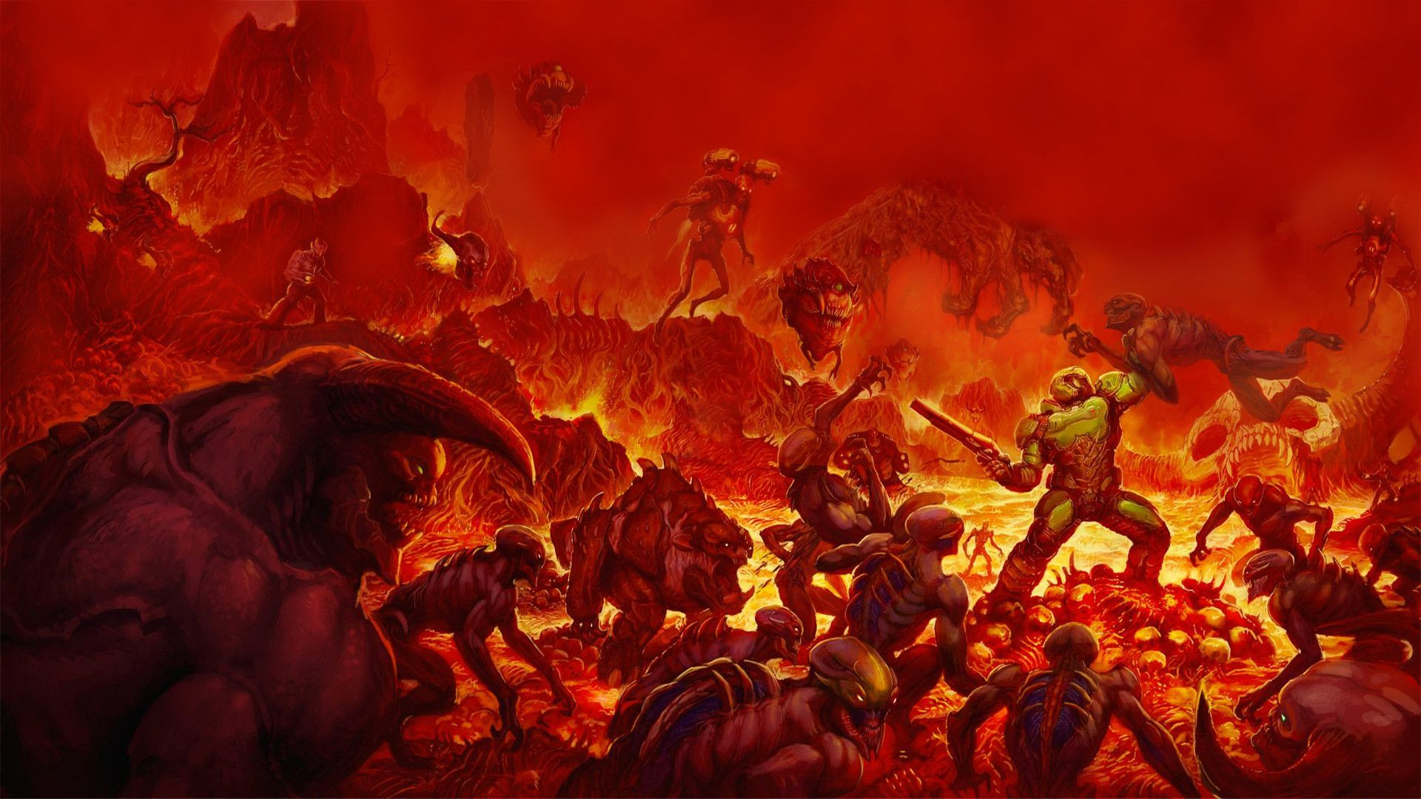
AT DOOM’S GATE BY MICK GORDON
-This is a piece used in the 2016 reboot of DOOM.
-Use of the genre of metal help emphasize The action and aggression shown in game
-Uses a guitar riff from the original, but also a new version that Gordon felt was more aggressive and grand
-The use of both the original and a beat drop into the new version helps show how the game itself is bigger and grander than the original
https://m.youtube.com/watch?v=Jly9qp40rfw

Slide 5
Conclusion

