Slide 1
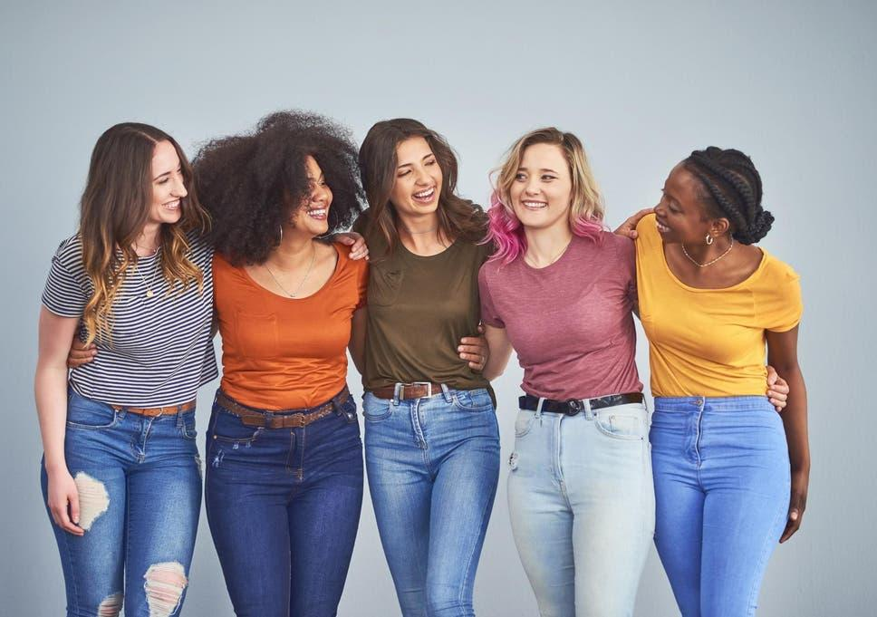
Music and Femininity
By: Liorah Felorian

Slide 2
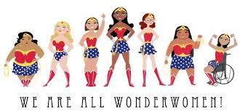
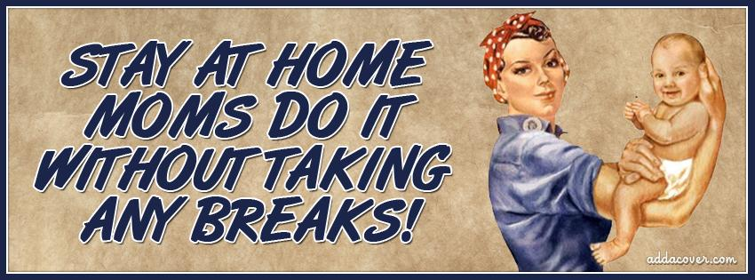
Background
Femininity is a set of attributes, behaviors, and roles associated with women. Society has made the image that women should stay home and raise children, while men be the breadwinners. Women face barriers such as gender roles, discrimination, and violence. I find this topic interesting, because although in history women have been frowned upon, music has opposed stereotypes and empowered women. This topic relates to music since female songwriters raise awareness of how women get treated. Some of their songs also include ways that society can help resolve these problems.

Slide 3
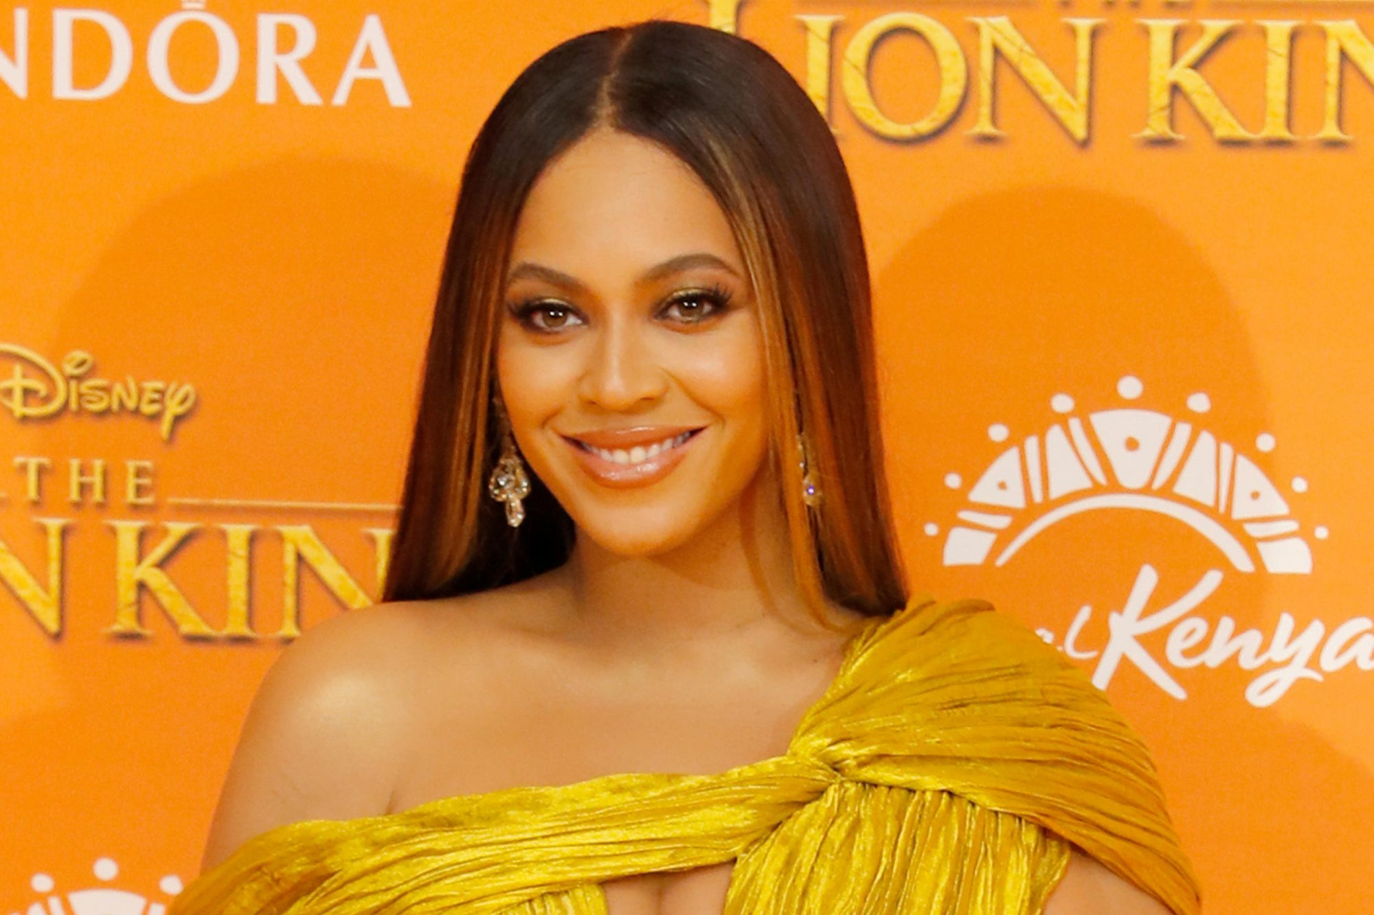
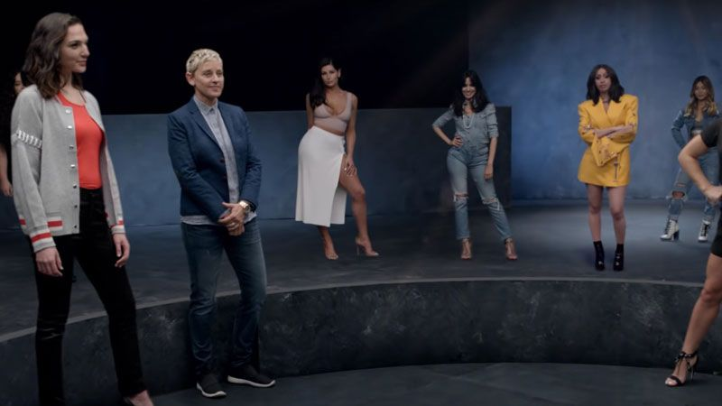
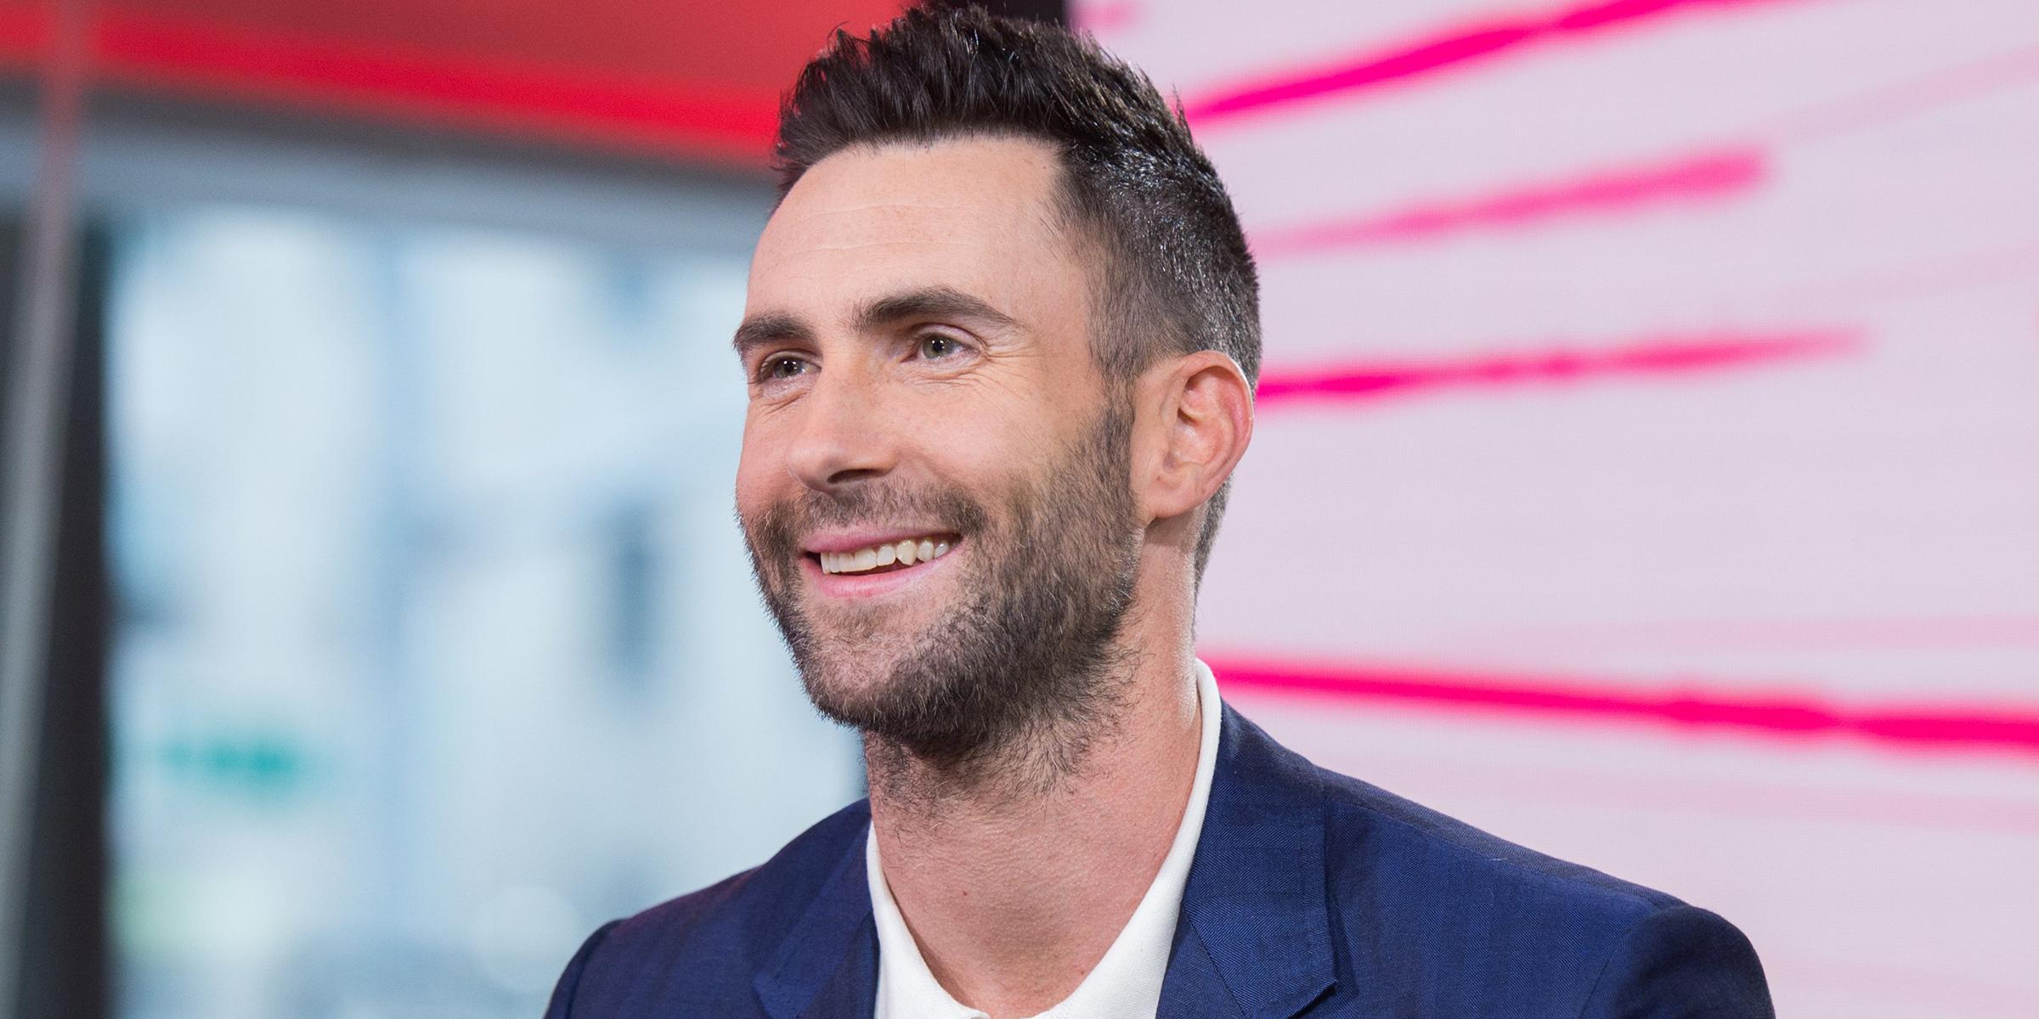
Run the World (Girls)
By Beyonce
The social context being in the desert, helps isolate the women and makes them the center of attention. Having this video made in the twenty-first century with a mixture of different cultures and eras, encourages the strength of women: “My persuasion can build a nation, endless power, our love we can devour, you'll do anything for me”. This piece relates to my topic, because it embraces women with different ethnicities and makes men look as if they are the inferior ones. One musical characteristic that relates to femininity would be the rhythm. The music was organized into distinct time units with a steady beat and tempo, as the women were marching. This refers to how women should keep their head high, and walk through obstacles in life as if they are unstoppable.
Youtube Link: https://youtu.be/VBmMU_iwe6U
Girls Like You
By Maroon 5
The circumstances of this video having a diverse group of women, tries to improve social values of racism and body shaming. The lead singer being a male proves how men support women fighting the patriarchy. Having a new girl every time the viewer circles around Adam Levine, shows that all women regardless of their color, size, or ethnicity are equal. The line “Girls like you love fun, yeah me too” proves that women and men at the end of the day are no different.The music does reflect my topic, because it focuses on a judgemental society about women. One musical characteristic that is relatable is the consonant harmony. The pleasing sound along with the repeated chorus stands out because it uses the pronoun “you” referring directly to any woman watching the video. It is trying to explain that we as a society should consider every woman as the same.
Youtube Link: https://youtu.be/cBVGlBWQzuc

