Slide 1
Music and Loss
Hila Bessalely Music 1

Slide 2
Topic: Music and Loss
How it relates to music:
Humans feel loss whether it's losing someone you loved as a partner, friend, or family. This can take place in losing loved ones through divorce, death, geographical distance, and more circumstances.
Music is one of the many ways aside from visual art, physical activity, dance or exercise in which people express their emotions.
Music can help deal with grief, and release sad emotions that were being held in denial.
Why I find this Topic Interesting:
I have used music in many circumstances to deal with, go through, and overcome sad emotions from loss
It interests me to learn and discover why music is so beneficial, and how others used it to connect to their losses

Slide 3
Playlist Entry: Billie Eilish- No Time to Die
https://www.youtube.com/watch?v=GB_S2qFh5lU&list=PL3-sRm8xAzY-v_i64uZfriFSPYHnQd8Vl&index=4
The darkness and simplicity of the photo relate to grief and feelings of loss.
The very slow and sad tempo and feeling of the song relate to the topic of loss. When someone loses a relationship or loved one it contributes to feelings of sadness. Someone who is going through grief could also be slow to move on and live their everyday life.
The tempo of the song and low pitch are musical characteristics that relate to the topic

Slide 4
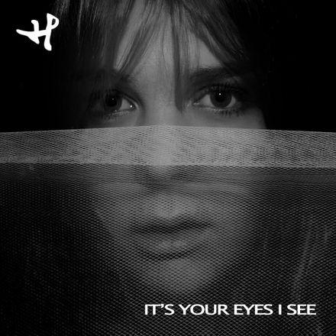
Playlist Entry : Hanne Leland- It’s Your Eyes I See
https://www.youtube.com/watch?v=XF-3rDdQjZk&list=PL3-sRm8xAzY-v_i64uZfriFSPYHnQd8Vl&index=5
This song portrays the denial and longing phase of the loss of someone.
For example, after a break up someone might be thinking of their ex constantly and maybe in denial that they won't see them forever. The line “There’s no rest in my sleep cause you’re there in my dreams” portrays the constant thinking and worrying about the person you lost.
The song uses repetition to emphasize certain lines. It repeats “It's your eyes I see haunting me” over and over.
When “haunting” is sung it is dragged out for many beats, as well as the music getting louder, to emphasize how she feels. Haunted emphasizes the grief and the sadness and recurring memories after loss.

