Slide 1
Music 1: Exploring music
Music and Film

Slide 2
Today we’ll be learning about…
How film music creates emotions and helps tell the story
Film music in Hollywood from the 1930s to 1950s
Film music in countries outside the US

Slide 3
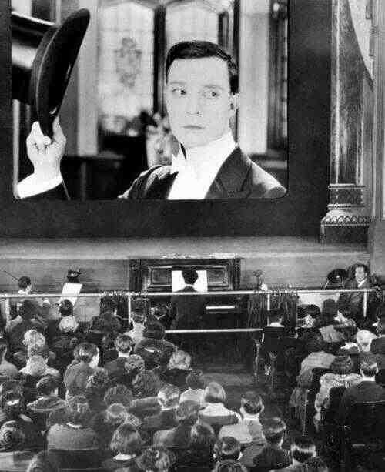
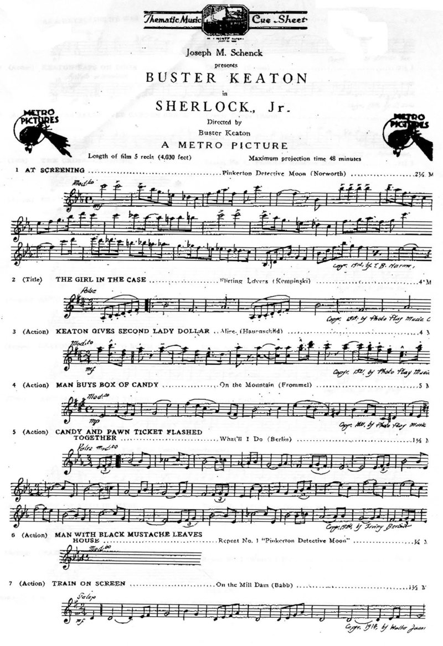
Silent Film Era (1891-1927)

Slide 4
Golden Age of Hollywood Musicals: 1930s-early 1950s
Studio System
Hays Code
32 Bar Form
Refer to textbook for discussion of terms
Ginger Rogers and Fred Astaire, “They All Laughed” from Shall We Dance (1937)
https://www.youtube.com/watch?v=_4C8r9hnQfs

Slide 5
Golden Age of Hollywood Musicals: 1930s-early 1950s
32 Bar Form
Race Films
Refer to textbook for discussion of terms
Ethel Waters and Bill Bailey, “Taking a Chance on Love” from Cabin in the Sky (1943)
https://www.youtube.com/watch?v=Ue_jOJ8GfhI

Slide 6
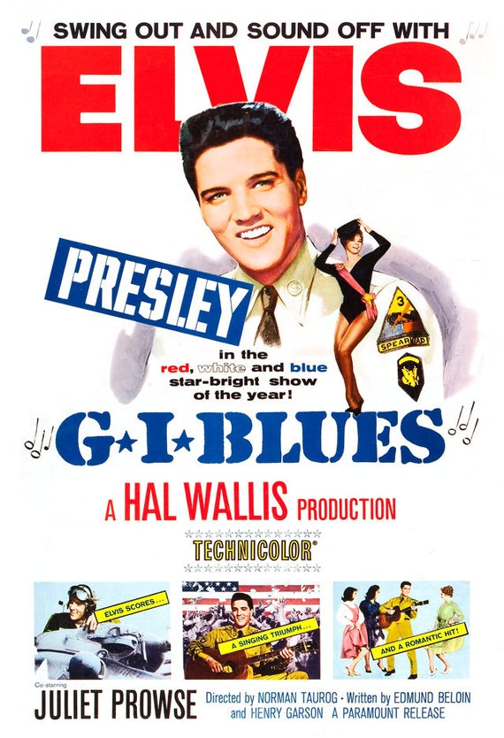
Hollywood Film Music After WWII
Collapse of studio system
Hays Code → MPAA Ratings
Diversification: pop stars and rock stars on screen

Slide 7
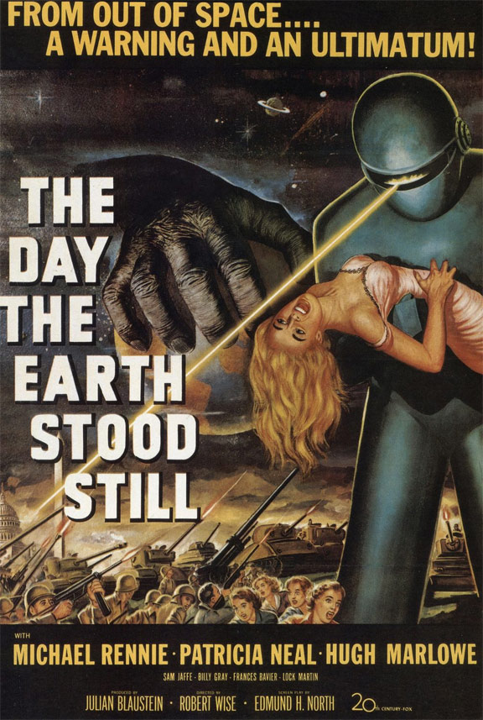
Opening Scene, The Day the Earth Stood Still (1951)
Bernard Herrmann (1911-1975)
Directed by Robert Wise
Music by Bernard Herrmann
- Partner to Alfred Hitchcock
Vertigo (1958)
North by Northwest (1959)
Psycho (1960)
The Birds (1963)
Refer to course schedule for link to clip; refer to textbook for musical discussion

Slide 8
Opening Scene, The Day the Earth Stood Still (1951)
Bernard Herrmann (1911-1975)
Theremin: electronic instrument that transforms electromagnetic waves from the human body into sound
https://www.youtube.com/watch?v=K6KbEnGnymk
Peter Pringle, performing Over the Rainbow on a 1929 RCA theremin used on film and TV soundtracks

Slide 9
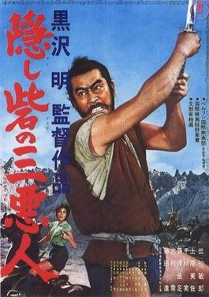
Fire festival scene, The Hidden Fortress (1958)
Music by Masaru Sato
Directed by Akira Kurosawa (1910-1998)
Fire festival scene features shakuhachi and taiko drums
Refer to course schedule for link to clip; refer to textbook for musical discussion

Slide 10
Five Minute Reflection
Pick either the scene from The Hidden Fortress or the opening to The Day the Earth Stood Still.
Describe the music that accompanied the scene/opening. What was going on visually?
What role did the music play for the audience in the scene/opening? Did it create emotion? Did it move the story along, or comment on the story?

Slide 11
Music and… Playlist Schedule
Revised proposal and description of one piece from your playlist
Paper
In-Class Wednesday, March 9
Midterm! Includes proposal and four pieces from your playlist
Email
Before Class Monday
March 23
Final!
Includes proposal, revised pieces from midterm, and final four pieces
Email
Before Class
Monday
May 4

Slide 12
Music and… Playlist Schedule
- Around 200 words (two to three paragraphs)
- Information on the social context of the piece
- How the piece works with or reflects your topic
- Discussion of at least one musical characteristic that relates to your topic text
Revised proposal and description of one piece from your playlist
Paper
In-Class Wednesday, March 9

Slide 13
“What does social context mean, anyway??”
The setting in which a piece of art (in this case music) was created
What I want you all to think about:
“How is the setting (time, place, circumstances, social values, etc.) reflected in the music?”
“Does the music express this setting?”
“If it doesn’t express the setting, why not? What does it express instead?”

