Slide 1
Music 1: Exploring music
Stocking our Musical Toolbox
Melody and Rhythm

Slide 2
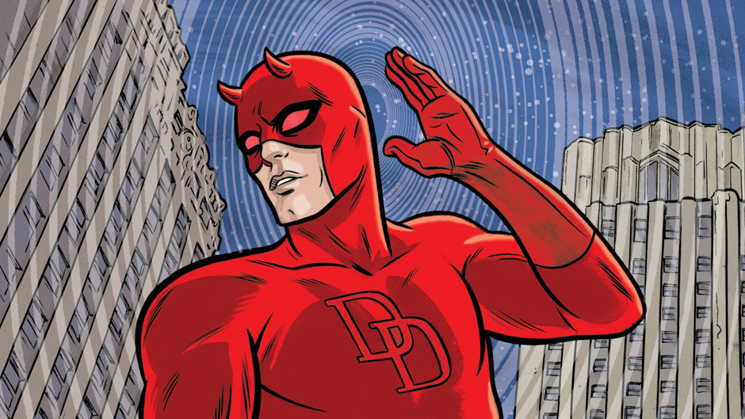
Today we’ll be asking…
How can we listen for melody, rhythm, and harmony in music?
What are some of the ways that individual sounds are organized to create music?

Slide 3
Our goal as listeners is to build a sonic road map out of the six elements of music
Melody
Rhythm
Harmony
Timbre
Texture
Form
“Hearing happens automatically. Engaged listening, however, requires mental focus.”

Slide 4
Elements of Music | Melody
A unit of pitches (or tones) sounded in succession--one after another
Melody is the tune of a piece of music, the part of the song that you would sing on your own

Slide 5
Elements of Music | Melody
Melodies can be described in terms of…
Their motion
Conjunct: having a short distance between pitches (think regular steps) → “Mary Had a Little Lamb”
Disjunct: having a long distance between pitches
(think big leaps) “Somewhere Over the Rainbow”
Their range: the distance between the highest and lowest pitches (narrow or wide)

Slide 6
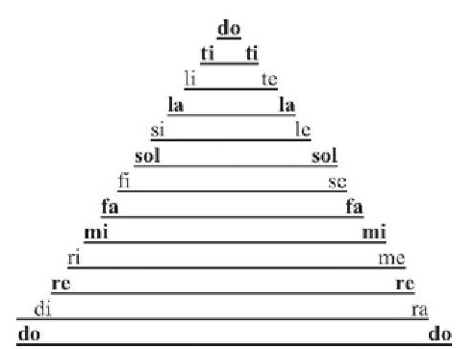
Elements of Music | Melody
Scale: a collection of pitches that forms the basis of a melody
Major scales and minor scales each have different patterns of gaps between pitches→different sounds; major=bright, minor=dark
“The Western melodic system is built upon the principle of tension and release”

Slide 7
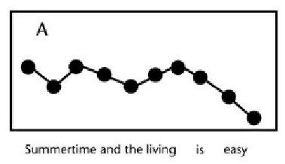
Elements of Music | Melody
“Happy Birthday to You”
While we hum “Happy Birthday,” use your hand to follow the melody of the song; the higher your hand, the higher the pitch, the lower your hand, the lower the pitch
Sing through the song in your head, or hum quietly. Instead of using your hand, sketch the direction of the melody on your worksheet

Slide 8
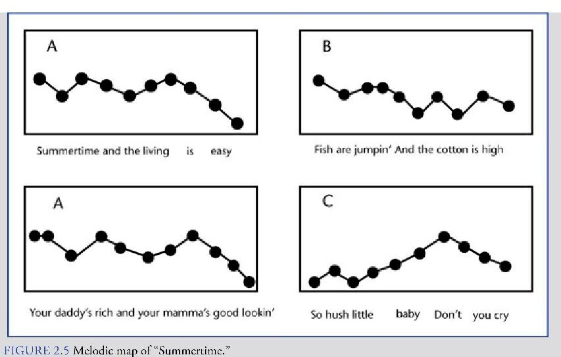
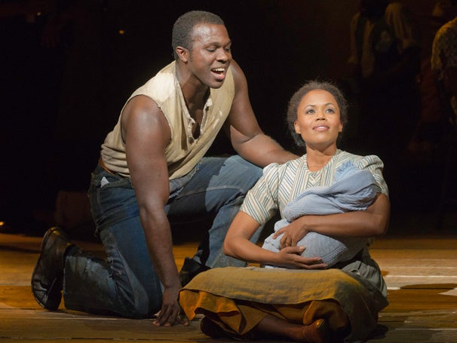
“Summertime,” from Porgy and Bess

Slide 9
Melody answers the question, “What pitches am I going to sing/play?”
Rhythm answers the question, “How long do I sing/play those pitches for?”

Slide 10
Elements of Music | Rhythm
Rhythm refers to the ways in which music is organized into distinct time units.
Beat: steady rhythmic pulse; the basic ingredient of rhythm; what a marching band steps to
Measure: repeated groups of strong and weak beats; a unit of rhythmic time
Tempo: the speed at which a piece of music or part of it is played; e.g. BPM (beats per minute) or Allegro, Andante, etc.

Slide 11
Elements of Music | Rhythm
A- ma- zing Grace, How sweet the sound
Short Long Short Long Short Long Short Long
That saved a wretch like me Short Long Short Long Short Long
I once was lost, but now am found Short Long Short Long Short Long Short Long
T'was blind but now I see
Short Long Short Long Short Long

Slide 12
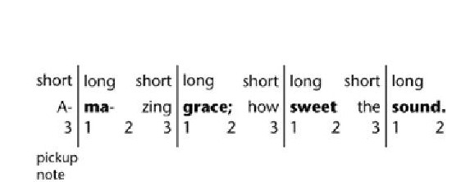
Elements of Music | Rhythm
Amazing Grace is in triple meter, because it has three beats in a measure (or multiples of 3)
Most popular music today, however, is either in duple meter, meaning it has 2 beats per measure, or quadruple meter (4 beats in a measure)

Slide 13
Elements of Music | Rhythm
Kotekan Pattern
Let’s test our rhythm! Every square is a beat X=clap; =cak; = silence

Slide 14
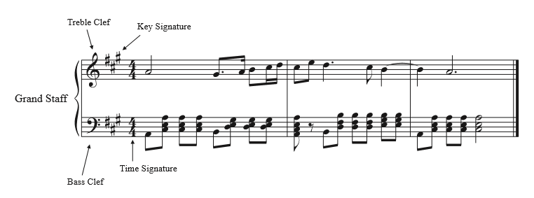
How are melody and rhythm notated?

Slide 15
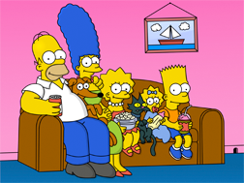
Elements of Music | Harmony
Harmony: the sounding of two or more pitches at the same time
Consonant: harmonies that sound pleasing
Dissonant: harmonies that sound harsh or clash
What count as consonant and what counts as dissonant can be different to different cultures (for example, the tritone)

Slide 16
Elements of Music | Harmony
Chord: three or more pitches that sound at the same time; built according to specific rules.
Like with scales, you can have major and minor chords
Lots of Western music is built around chord progressions (or harmonic progressions), sequences of chords that move from stability to tension to stability

