Slide 1
Music 1: Exploring music
Stocking our Musical Toolbox
Harmony, Texture, Timbre, Form

Slide 2
Reviewing Melody, Rhythm, and Western Art Music
With the person to your right (or behind you), look over your notes from last week on Western Art music, melody, and rhythm.
Come up with one concept that was new and/or interesting to you and one concept that you found challenging.

Slide 3
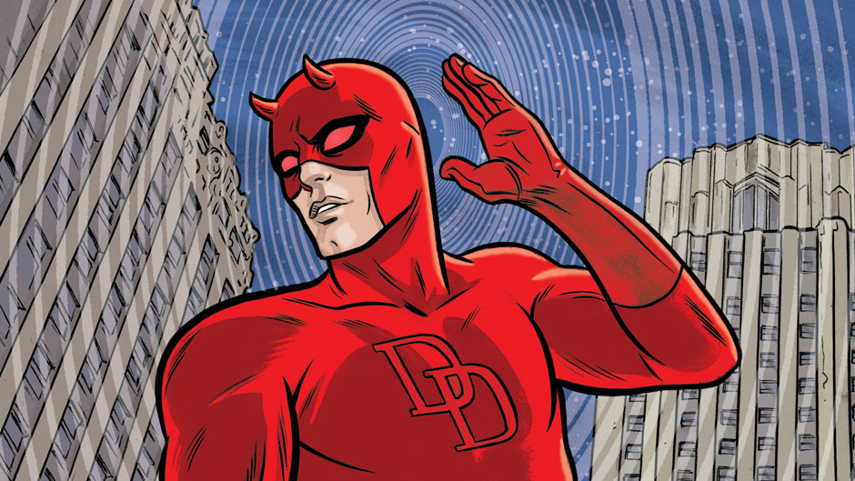
Today we’ll be asking…
How can we listen for timbre, texture, and form in music?
What are some of the ways that individual sounds are organized to create music?

Slide 4
Elements of Music | Harmony
Harmony: the sounding of two or more pitches at the same time
Consonant: harmonies that sound pleasing
Dissonant: harmonies that sound harsh or clash
What count as consonant and what counts as dissonant can be different to different cultures (for example, the tritone)

Slide 5
Elements of Music | Harmony
Chord: three or more pitches that sound at the same time; built according to specific rules.
Like with scales, you can have major and minor chords
Lots of Western music is built around chord progressions (or harmonic progressions), sequences of chords that move from stability to tension to stability

Slide 6
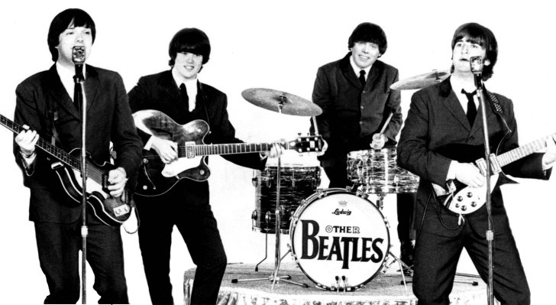
Elements of Music | Texture
Texture: the ways in which different musical parts fit together.
What are some of the “different musical parts” you can think of that make up a piece of music?

Slide 7
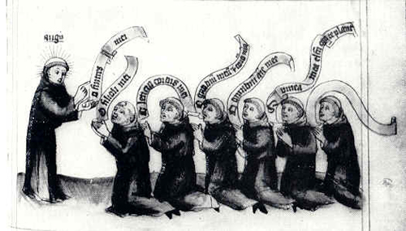
Elements of Music | Texture
Monophony:
A single musical line without accompaniment.

Slide 8
Elements of Music | Texture
Polyphony:
Several independent lines sounding simultaneously.

Slide 9
Elements of Music | Texture
Homophony:
Melody plus chordal accompaniment.

Slide 10
Elements of Music | Texture
Heterophony:
A single basic melody performed slightly differently by two or more performers.

Slide 11
Elements of Music | Texture
Biphony:
Two separate lines, consisting of a melody and a drone.

Slide 12
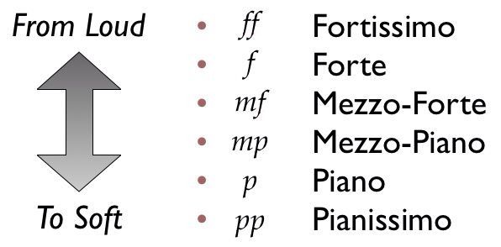
Elements of Music
Dynamics: the volume of a note or passage of music.
In Western Art music, Italian terms are used to indicate how loudly or softly to play.

Slide 13
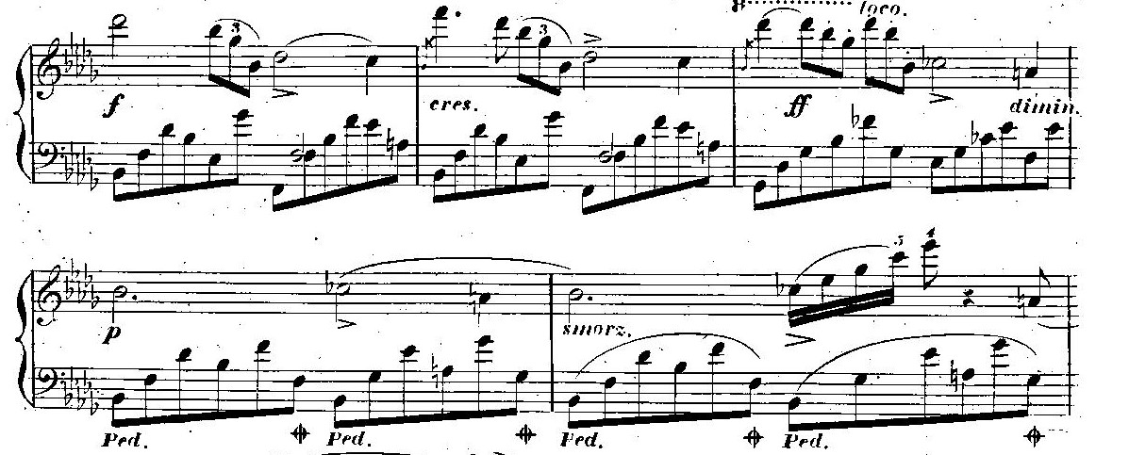
Elements of Music
Dynamics: the volume of a note or passage of music.

Slide 14
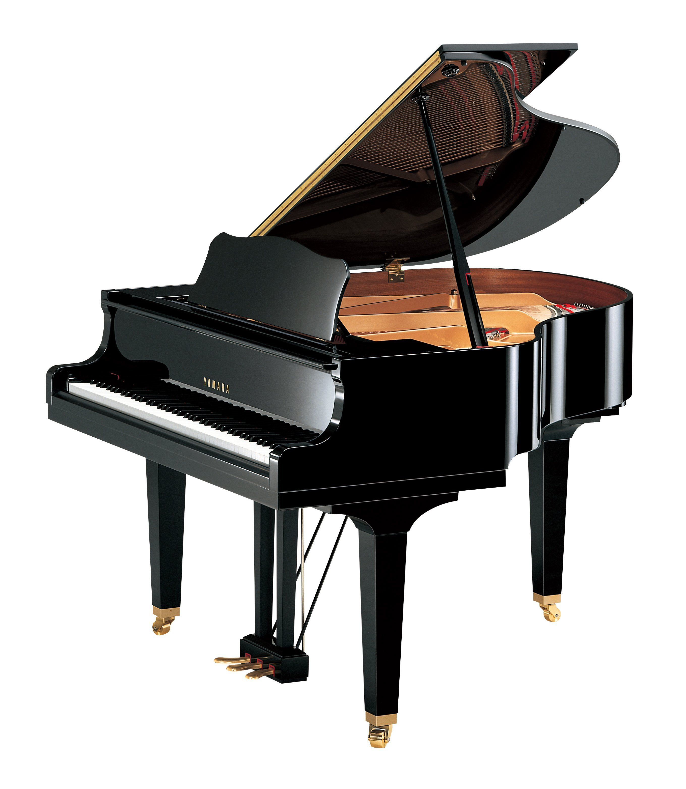
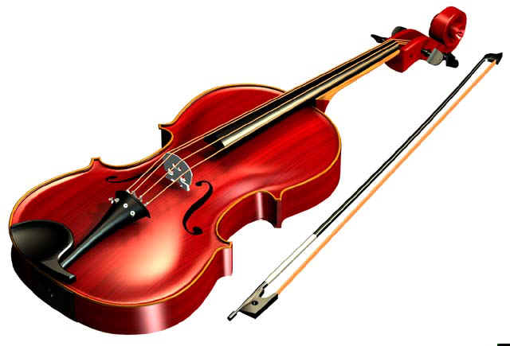
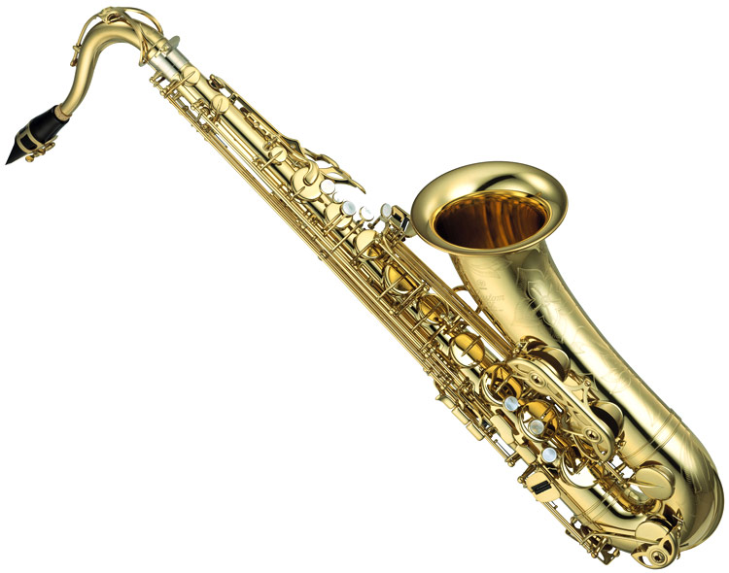
Elements of Music | Timbre
The particular sound or color of an instrument that makes it unique

Slide 15
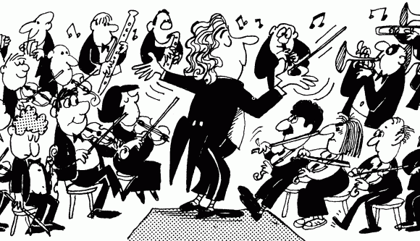
Elements of Music | Timbre
Musical instruments are classified in many different ways
The most common division in the West includes:
Strings
Woodwinds
Brass
Percussion

Slide 16
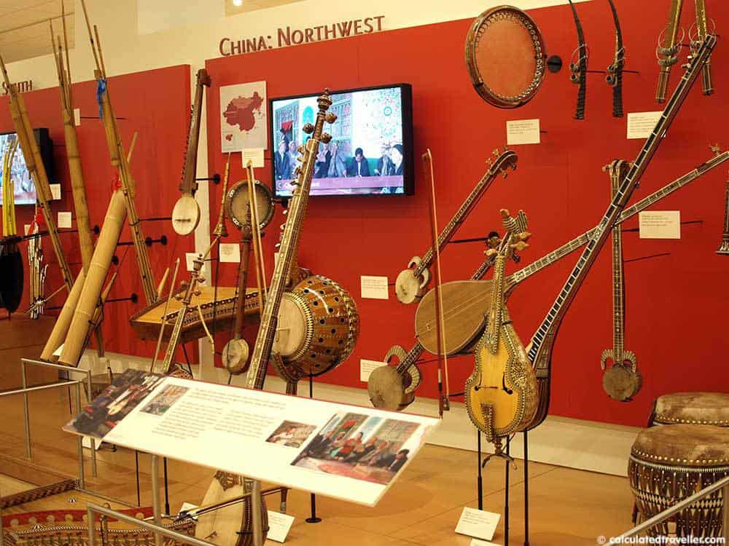
Elements of Music | Timbre
Musical instruments are classified in many different ways
Hornbostel and Sachs Classification System:
Chordophones
Aerophones
Membranophones
Idiophones
Electrophones

Slide 17
Elements of Music | Form
Form: the overall shape or structure of a piece of music.
Some examples:
- AABA (32 Bar Form)
- 12-bar Blues
- Binary
- Ternary
- Rondo
- Sonata
- Verse-Chorus

Slide 18
Elements of Music | Form
How is form different than genre?
Genre refers to a “type” or “kind” of music that is defined by many different things
Form refers specifically to how a piece of music is structured
A specific form can be associated with a genre, like verse-chorus with rock

Slide 19
Elements of Music | Form
Examples of Musical Genres in Western Art Music
- Song
- Symphony
- Concerto
- Sonata
- Opera
- Chamber Music
There are forms within all of these genres!

